Slide 1

CISC450 Computer Networks
Lesson 1
Data Transmission and Media
Slides courtesy of
William Stallings

Slide 2
Terminology (1)
Transmitter
Receiver
Medium
  Guided medium
    e.g. twisted pair, optical fiber
  Unguided medium
    e.g. air, water, vacuum

Slide 3
Terminology (2)
Direct link
  No intermediate devices
Point-to-point
  Direct link
  Only 2 devices share link
Multi-point
  More than two devices share the link

Slide 4
Terminology (3)
Simplex
  One direction
    e.g. Television
Half duplex
  Either direction, but only one way at a time
    e.g. police radio
Full duplex
  Both directions at the same time
    e.g. telephone

Slide 5
Frequency, Spectrum and Bandwidth
Time domain concepts
  Continuous signal
    Various in a smooth way over time
  Discrete signal
    Maintains a constant level then changes to another constant level
  Periodic signal
    Pattern repeated over time
  Aperiodic signal
    Pattern not repeated over time

Slide 6
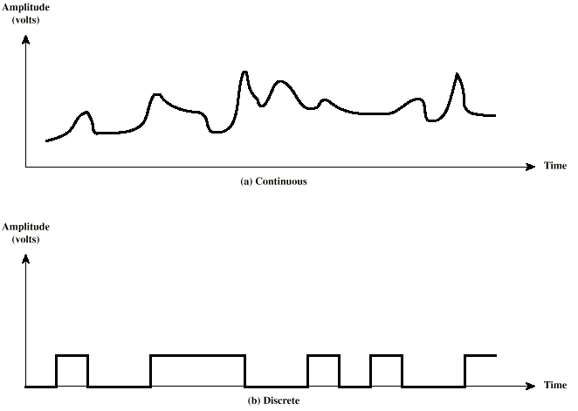
Continuous & Discrete Signals

Slide 7
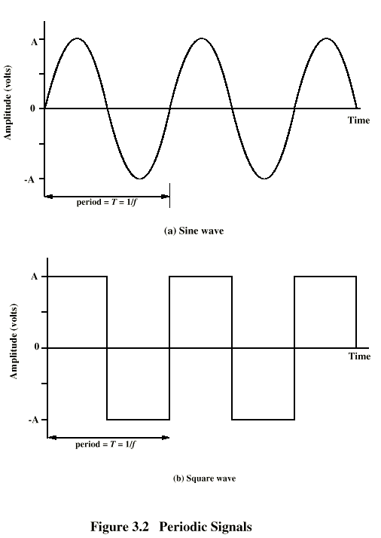
Periodic
Signals

Slide 8
Sine Wave
Peak Amplitude (A)
  maximum strength of signal
  volts
Frequency (f)
  Rate of change of signal
  Hertz (Hz) or cycles per second
  Period = time for one repetition (T)
  T = 1/f
Phase (φ)
  Relative position in time

Slide 9
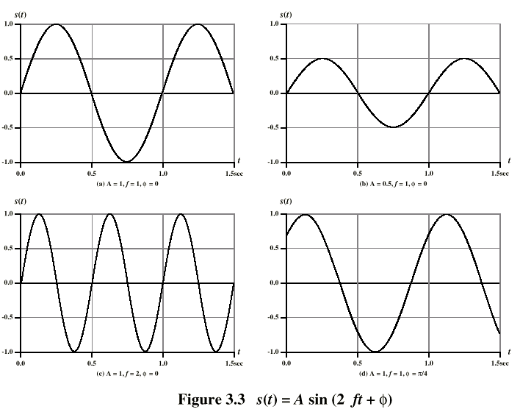
Varying Sine Waves

Slide 10
Wavelength
Distance occupied by one cycle
Distance between two points of corresponding phase in two consecutive cycles
λ
Assuming signal velocity v
  λ = vT
  λf = v
  c = 3*10⁸ ms⁻¹ (speed of light in free space)

Slide 11
Frequency Domain Concepts
Signal usually made up of many frequencies
Components are sine waves
Can be shown (Fourier analysis) that any signal is made up of component sine waves
Can plot frequency domain functions

Slide 12
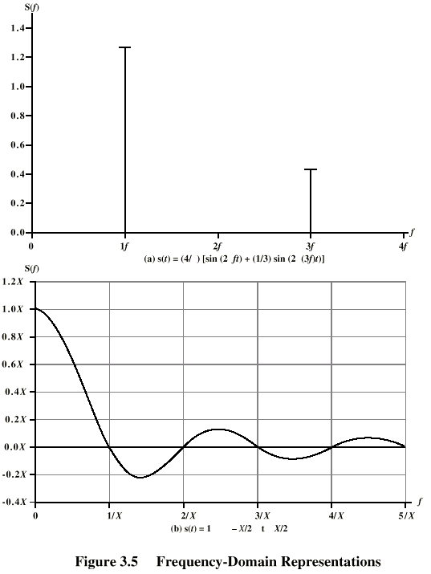
Frequency
Domain

Slide 13
Spectrum & Bandwidth
Spectrum
  range of frequencies contained in signal
Absolute bandwidth
  width of spectrum
Effective bandwidth
  Often just bandwidth
  Narrow band of frequencies containing most of the energy
DC Component
  Component of zero frequency

Slide 14
Data Rate and Bandwidth
Any transmission system has a limited band of frequencies
This limits the data rate that can be carried

Slide 15
Analog and Digital Data Transmission
Data
  Entities that convey meaning
Signals
  Electric or electromagnetic representations of data
Transmission
  Communication of data by propagation and processing of signals

Slide 16
Data
Analog
  Continuous values within some interval
  e.g. sound, video
Digital
  Discrete values
  e.g. text, integers

Slide 17
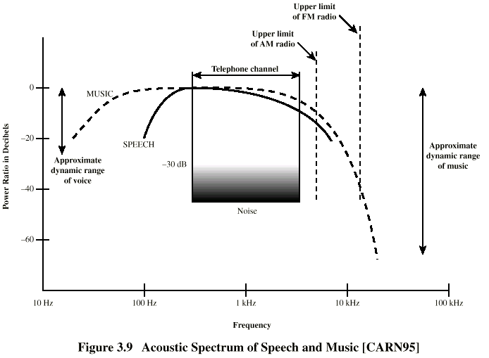
Acoustic Spectrum (Analog)

Slide 18
Signals
Means by which data are propagated
Analog
  Continuously variable
  Various media
    wire, fiber optic, space
  Speech bandwidth 100Hz to 7kHz
  Telephone bandwidth 300Hz to 3400Hz
  Video bandwidth 4MHz
Digital
  Use two DC components

Slide 19
Data and Signals
Usually use digital signals for digital data and analog signals for analog data
Can use analog signal to carry digital data
  Modem
Can use digital signal to carry analog data
  Compact Disc audio

Slide 20
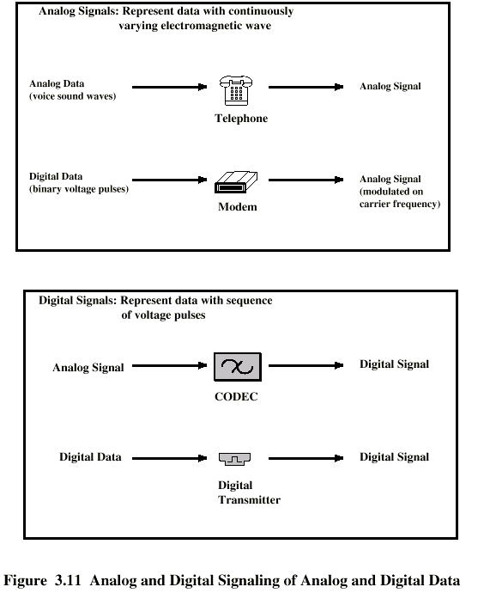
Analog Signals Carrying Analog and Digital Data

Slide 21
Digital Signals Carrying Analog and Digital Data

Slide 22
Analog Transmission
Analog signal transmitted without regard to content
May be analog or digital data
Attenuated over distance
Use amplifiers to boost signal
Also amplifies noise

Slide 23
Digital Transmission
Concerned with content
Integrity endangered by noise, attenuation etc.
Repeaters used
Repeater receives signal
Extracts bit pattern
Retransmits
Attenuation is overcome
Noise is not amplified

Slide 24
Advantages of Digital Transmission
Digital technology
  Low cost LSI/VLSI technology
Data integrity
  Longer distances over lower quality lines
Capacity utilization
  High bandwidth links economical
  High degree of multiplexing easier with digital techniques
Security & Privacy
  Encryption
Integration
  Can treat analog and digital data similarly

Slide 25
Transmission Impairments
Signal received may differ from signal transmitted
Analog - degradation of signal quality
Digital - bit errors
Caused by
  Attenuation and attenuation distortion
  Delay distortion
  Noise

Slide 26
Attenuation
Signal strength falls off with distance
Depends on medium
Received signal strength:
  must be enough to be detected
  must be sufficiently higher than noise to be received without error
Attenuation is an increasing function of frequency

Slide 27
Delay Distortion
Only in guided media
Propagation velocity varies with frequency

Slide 28
Noise (1)
Additional signals inserted between transmitter and receiver
Thermal
  Due to thermal agitation of electrons
  Uniformly distributed
  White noise
Intermodulation
  Signals that are the sum and difference of original frequencies sharing a medium

Slide 29
Noise (2)
Crosstalk
  A signal from one line is picked up by another
Impulse
  Irregular pulses or spikes
  e.g. External electromagnetic interference
  Short duration
  High amplitude

Slide 30
Channel Capacity
Data rate
  In bits per second
  Rate at which data can be communicated
Bandwidth
  In cycles per second of Hertz
  Constrained by transmitter and medium

Slide 31
Overview
Guided - wire
Unguided - wireless
Characteristics and quality determined by medium and signal
For guided, the medium is more important
For unguided, the bandwidth produced by the antenna is more important
Key concerns are data rate and distance

Slide 32
Design Factors
Bandwidth
  Higher bandwidth gives higher data rate
Transmission impairments
  Attenuation
Interference
Number of receivers
  In guided media
  More receivers (multi-point) introduce more attenuation

Slide 33
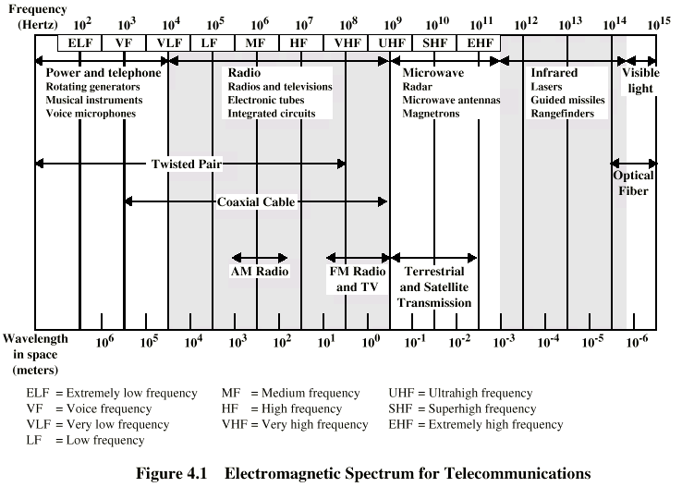
Electromagnetic Spectrum

Slide 34
Guided Transmission Media
Twisted Pair
Coaxial cable
Optical fiber

Slide 35
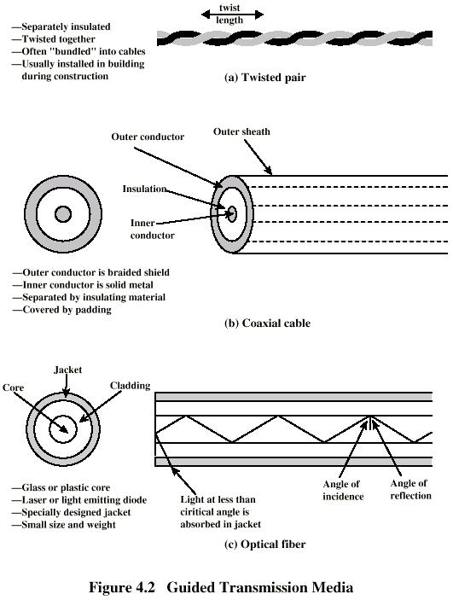
Twisted Pair

Slide 36
Twisted Pair - Applications
Most common medium
Telephone network
  Between house and local exchange (subscriber loop)
Within buildings
  To private branch exchange (PBX)
For local area networks (LAN)
  10Mbps or 100Mbps

Slide 37
Twisted Pair - Pros and Cons
Cheap
Easy to work with
Low data rate
Short range

Slide 38
Twisted Pair - Transmission Characteristics
Analog
  Amplifiers every 5km to 6km
Digital
  Use either analog or digital signals
  repeater every 2km or 3km
Limited distance
Limited bandwidth (1MHz)
Limited data rate (100MHz)
Susceptible to interference and noise

Slide 39
Unshielded and Shielded TP
Unshielded Twisted Pair (UTP)
  Ordinary telephone wire
  Cheapest
  Easiest to install
  Suffers from external EM interference
Shielded Twisted Pair (STP)
  Metal braid or sheathing that reduces interference
  More expensive
  Harder to handle (thick, heavy)

Slide 40
UTP Categories
Cat 3
  up to 16MHz
  Voice grade found in most offices
  Twist length of 7.5 cm to 10 cm
Cat 4
  up to 20 MHz
Cat 5
  up to 100MHz
  Commonly pre-installed in new office buildings
  Twist length 0.6 cm to 0.85 cm

Slide 41
Near End Crosstalk
Coupling of signal from one pair to another
Coupling takes place when transmit signal entering the link couples back to receiving pair
i.e. near transmitted signal is picked up by near receiving pair

Slide 42
Coaxial Cable

Slide 43
Coaxial Cable Applications
Most versatile medium
Television distribution
  Ariel to TV
  Cable TV
Long distance telephone transmission
  Can carry 10,000 voice calls simultaneously
  Being replaced by fiber optic
Short distance computer systems links
Local area networks

Slide 44
Coaxial Cable - Transmission Characteristics
Analog
  Amplifiers every few km
  Closer if higher frequency
  Up to 500MHz
Digital
  Repeater every 1km
  Closer for higher data rates

Slide 45
Optical Fiber

Slide 46
Optical Fiber - Benefits
Greater capacity
  Data rates of hundreds of Gbps
Smaller size & weight
Lower attenuation
Electromagnetic isolation
Greater repeater spacing
  10s of km at least

Slide 47
Optical Fiber - Applications
Long-haul trunks
Metropolitan trunks
Rural exchange trunks
Subscriber loops
LANs

Slide 48
Optical Fiber - Transmission Characteristics
Act as wave guide for 10¹⁴ to 10¹⁵ Hz
  Portions of infrared and visible spectrum
Light Emitting Diode (LED)
  Cheaper
  Wider operating temp range
  Last longer
Injection Laser Diode (ILD)
  More efficient
  Greater data rate
Wavelength Division Multiplexing

Slide 49
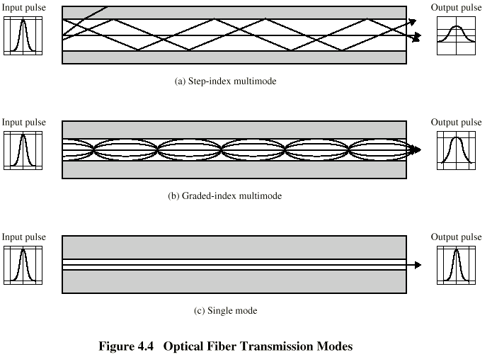
Optical Fiber Transmission Modes

Slide 50
Wireless Transmission
Unguided media
Transmission and reception via antenna
Directional
  Focused beam
  Careful alignment required
Omnidirectional
  Signal spreads in all directions
  Can be received by many antennae

Slide 51
Frequencies
2GHz to 40GHz
  Microwave
  Highly directional
  Point to point
  Satellite
30MHz to 1GHz
  Omnidirectional
  Broadcast radio
3 x 10¹¹ to 2 x 10¹⁴
  Infrared
  Local

Slide 52
Terrestrial Microwave
Parabolic dish
Focused beam
Line of sight
Long haul telecommunications
Higher frequencies give higher data rates

Slide 53
Satellite Microwave
Satellite is relay station
Satellite receives on one frequency, amplifies or repeats signal and transmits on another frequency
Requires geo-stationary orbit
  Height of 35,784km
Television
Long distance telephone
Private business networks

Slide 54
Broadcast Radio
Omnidirectional
FM radio
UHF and VHF television
Line of sight
Suffers from multipath interference
  Reflections

Slide 55
Infrared
Modulate noncoherent infrared light
Line of sight (or reflection)
Blocked by walls
e.g. TV remote control, IRD port

